Slide 1
MATLAB Olympic-Games
By Andreas & David (Student Ambassadors @TU-Munich)
23.02.2021

Slide 2

MATLAB Olympics - what’s that?
At a glance:
Synchronous online event in which students form teams to solve MATLAB problems
Prize pool made up from goodies and Amazon gift cards serve as prizes
(Planned) duration: 1.5h
Two primary objectives:
Students get to know MATLAB in a playful manner
Facilitate an environment where students can chat with each other and have fun

Slide 3
Roadmap Overview
What are the necessary steps?
Agree on a broad concept or theme
Prepare the content
Come up with a marketing campaign
Hold the event

Slide 4
Roadmap Conceptual Phase
What are the necessary steps?
Agree on a broad concept or theme
Prepare the content
Come up with a marketing campaign
Hold the event

Slide 5


Roadmap Conceptual Phase
Deciding on the theme of the event is the single most important decision during the preparation
This determines:
the content, to be prepared
the target audience
Freshman welcoming and X-mas are two well suited themes

Slide 6
Roadmap Design Phase
What are the necessary steps?
Agree on a broad concept or theme
Prepare the content
Come up with a marketing campaign
Hold the event

Slide 7
Design Phase
Possible Frameworks for MATLAB-Events:
MATLAB Academy, MATLAB Grader, Cody, …
or:
Custom MATLAB Live Script + Function Files
Allows for nice formatting
Problem description
Pictures
Formulas
Act as canvases
Allow for creativity
Multiple solutions possible
Familiarize with functions (calls)

Slide 8
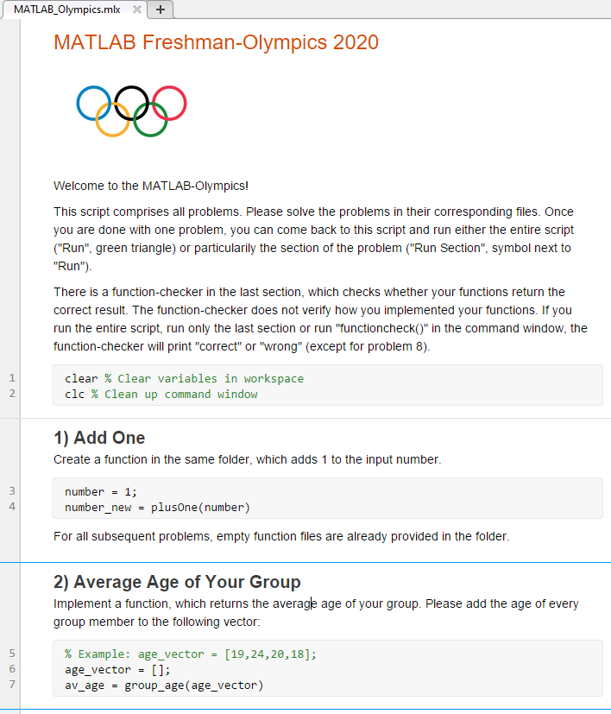
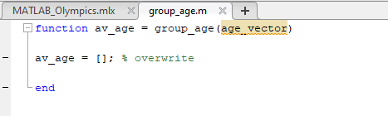
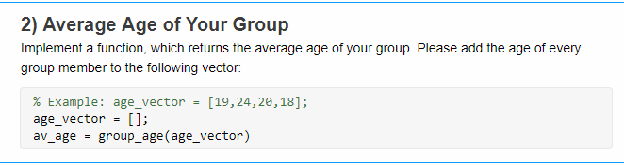
Design Phase
Live Script
Comprises problem descriptions and function calls
Function Files
Where participants solve the problem

Slide 9
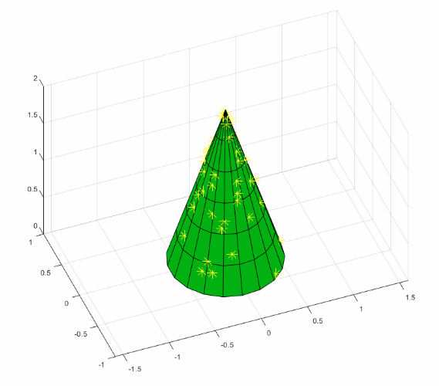
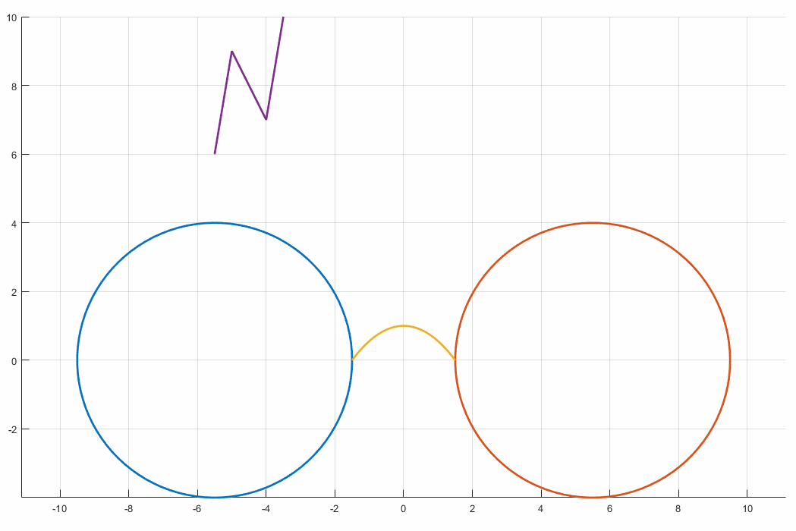
Design Phase
Ideas for types of problems
Implementation of algorithms (prime numbers, recursive Fibonacci series)
Object detection
Problems related to MATLAB functionality, e. g. plotting
“Harry Plotter”
Christmas tree with random lights

Slide 10
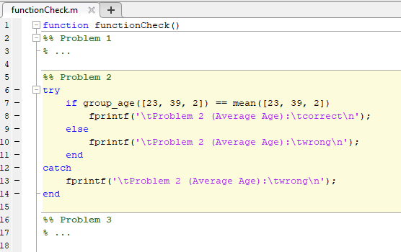
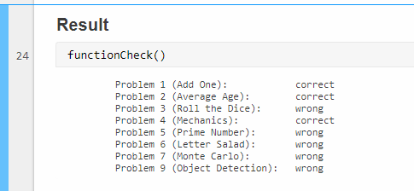
Design Phase
How to check whether problems are solved correctly?
Write a p-coded function
Call all problem-functions with arbitrary input
Check for correct output
Print “correct” or “wrong” per problem-function
At the end of the live script:

Slide 11


Design Phase
How to distribute the files?
live script
prepared problem-functions
p-coded function-checker
supplemental material
Upload to social media platform
zip-file

Slide 12
Design Phase
Benefits of events with live scripts
Students work directly in MATLAB
Full flexibility regarding the theme of your event and the types of problems
Promote your social media channel by having participants join and download the files

Slide 13
Roadmap Organizational Affairs
Agree on a broad concept or theme
Prepare the content
Come up with a marketing campaign
Hold the event

Slide 14




Organizational Affairs
Get the students attention
Create and share flyers, banners, …
Using multiple channels
Think about fruitful collaborations
Collaboration with student council and other student initiatives
Decide on a price pool
Mix of physical goodies and Amazon gift cards

Slide 15
Roadmap Showtime
Agree on a broad concept or theme
Prepare the content
Come up with a marketing campaign
Hold the event

Slide 16

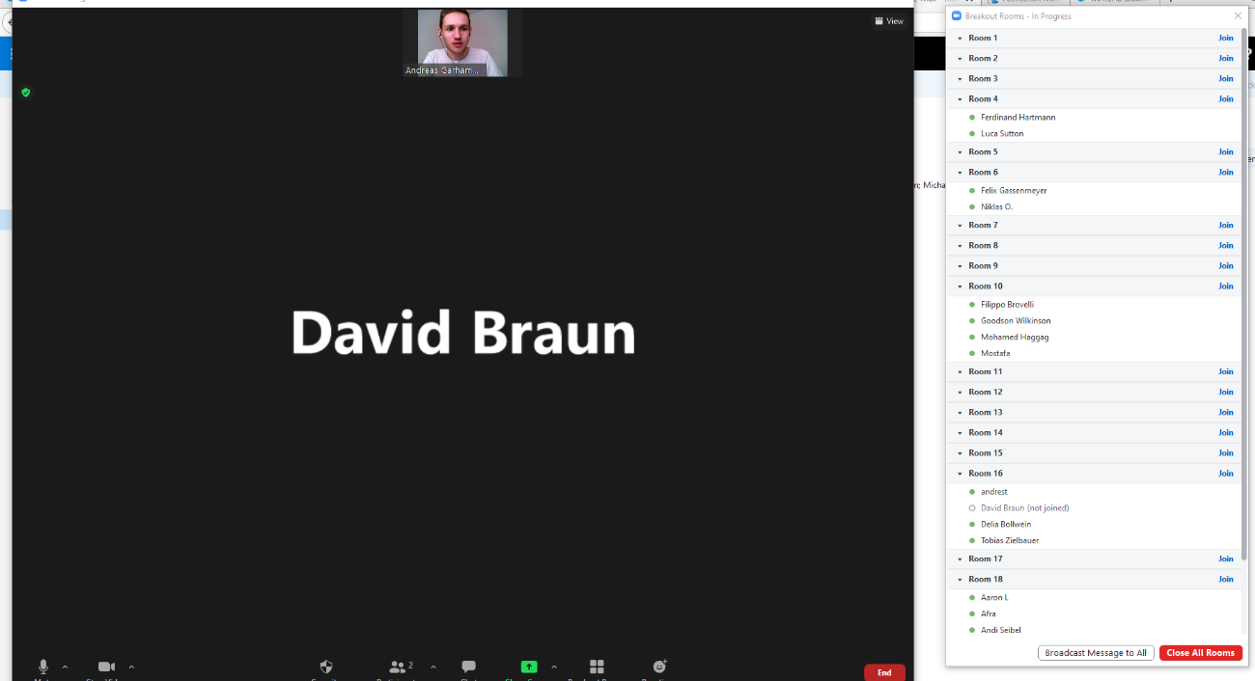
Showtime
Introduction & Code Distribution
Students form groups of four
Each group is assigned to a break-out room
Hosts help with problems
„Medal ceremony“
break-out rooms

Slide 17

Conclusion & Lessons Learned
How did the event go?
90 students with no MATLAB-experience joined the event
Students were ambitiously working for 4.5 hours instead of scheduled 1.5 hours
Received a lot of positive feedback ☺
Expect the unexpected!
How many participants will show up?
What’s the average level of experience (wrt. MATLAB)?

Slide 18
Thank you very much!
Any questions?

